Slide 1
Protected Health Information and APCD Security
Spyridon Ganas

Slide 2
What is PHI?
Wikipedia defines Protected Health Information (PHI) as “any information about health status, provision of health care, or payment for health care” that “can be linked to a specific individual.”
PHI can include:
Medical records
Insurance company bills
Referral and prior authorization documents
Medical test results
Unauthorized release of PHI can lead to fines of up to $50,000 per incident.

Slide 3
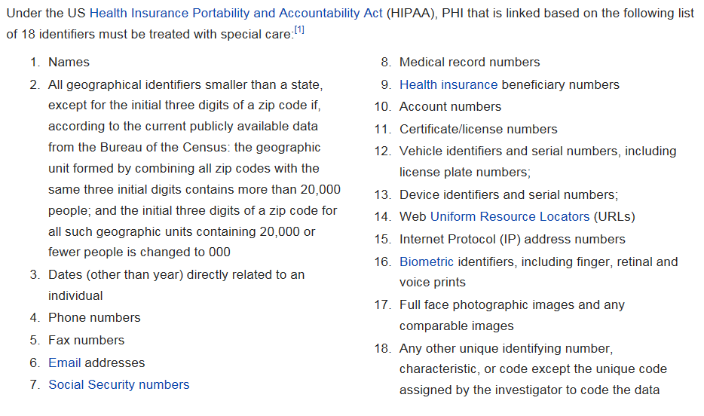
PHI Identifiers

Slide 4
PHI in the APCD
Date elements containing PHI identifiers are encrypted in the APCD
CHIA classifies data elements based on the data’s security risk:
Level 1 – Public Use
Level 2 – Restricted; Available to Government Agencies, Providers, Payer, Researchers and Qualified Individuals following approval by the Data Privacy Committee.
Level 3 – No Release; Available to Government Agencies, Providers, Payer following approval by the Data Privacy Committee.

Slide 5
Limited Data Sets
Limited Data Sets (LDS) are a subset of APCD data that were designed to exclude PHI identifiers.
LDSes have been pre-approved for release to researchers
When a researcher requests only LDS data, their request is fast-tracked and they are able to avoid the full data privacy committee review.

Slide 6
References
https://en.wikipedia.org/wiki/Protected_health_information
http://www.ama-assn.org/ama/pub/physician-resources/solutions-managing-your-practice/coding-billing-insurance/hipaahealth-insurance-portability-accountability-act/hipaa-violations-enforcement.page
http://www.chiamass.gov/privacy-program/
http://www.chiamass.gov/assets/docs/p/apcd/release1/data-release-regulation-957-5.pdf

